Slide 1
The Danish welfare model
The policy areas in the Ministry of Social Affairs
And The National Board of Social Services

Slide 2
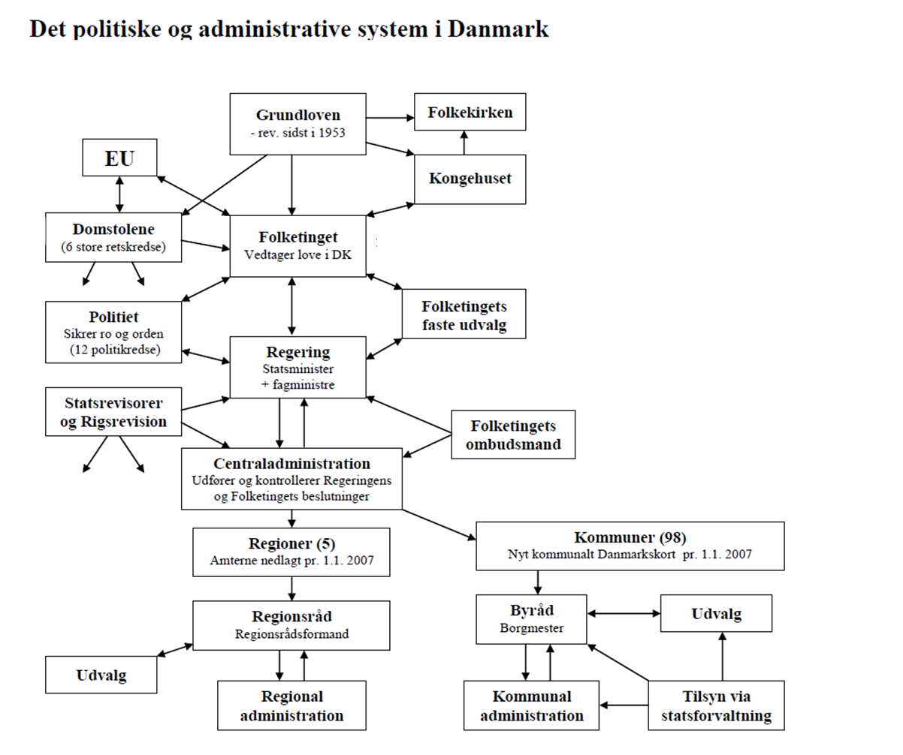

Slide 3
Welfare models
Welfare Models | Universal Model | Residual Model | Labour-based Model
Country: | Denmark, Sweden, Norway | USA, UK, Australia | Germany, France, Holland and others
Who is responsible | government | The person himself. Private charity | Labour, State and family
Financing of social services | To be financed through taxes | private insurance. State limited | To be financed through compulsory social contributions
Who will receive | Everyone gets in principle the same | Only the weakest receiver and benefits are low | All social benefits, but persons who are or have been linked to the labor receive most
Who has the most benefit: | People with low incomes and unstable attachment to the labor | They serve mostly because low taxes | Individuals who are related to work
Social redistribution | Great | Small | Intermediate

Slide 4
THE GENERAL FRAMEWORK OF SOCIAL POLICY IN DENMARK
The Danish welfare model is based on the principle that all citizens shall be guaranteed certain fundamental rights in case they encounter social problems such as unemployment, sickness or dependency.

Slide 5
The social system is characterised by the following principles:
Universalism. All citizens in need are entitled to receive social security benefits and social services – regardless of their affiliation to the labour market.
• Tax financing. Social security benefits and social services are mainly financed from general taxation.
• Public responsibility. The public sector is responsible for the provision of social security benefits and social services.
• Possibilities of labour market affiliation. Improved services for children, dependent elderly persons and disabled people contribute to interconnecting family life with working life.
Active social measures. Social protection measures must be active – rather than merely passive support and maintenance

Slide 6
The social system is characterised by the following principles:
Local community approach.The social sector is organised with a high degree of decentralisation of social responsibilities to local government.
Local scope of action.Local authorities and regions have wide autonomy when implementing the various social protection schemes.
User influence.Citizens and claimants must be involved in the organisation of a social protection programme.
Comprehensive view. The citizen’s social problems and his or her situation must be seen in a broader context.
•Cooperation with other social players.The public sector co-operates with private companies and voluntary social organisations to promote social welfare.

Slide 7
Social Affairs
The Ministry is responsible for a wide range of social issues, i.a. disadvantaged children, socially disadvantaged people, taking care of the elderly and disability policy.
The National Board of Social Services is a public advisory and development organisation under The Ministry.
We provide current knowledge, advice and process support in social affairs

Slide 8
Facts about the National Board of Social Services
Approx. 350 employees
Headquarter in Odense
Divisions throughout Denmark

Slide 9
Organisation
Director
Management Secretariat
Vicedirector
Head of Department
Physical Disabilities, Aids, Equipment and Technology
Communication, rare disabilities and special education
Socialsupervison and National Coordination Unit
Documentation and methodology
Cognitive disabilities and brain damages
Adults with social problems
Children and family
Economy, business development and operation
VISO
National Organisation for Knowledge and Specialist Consultancy.
Elderly people and dementia
Vulnerable adolescents and integration
Mental Health

Slide 10
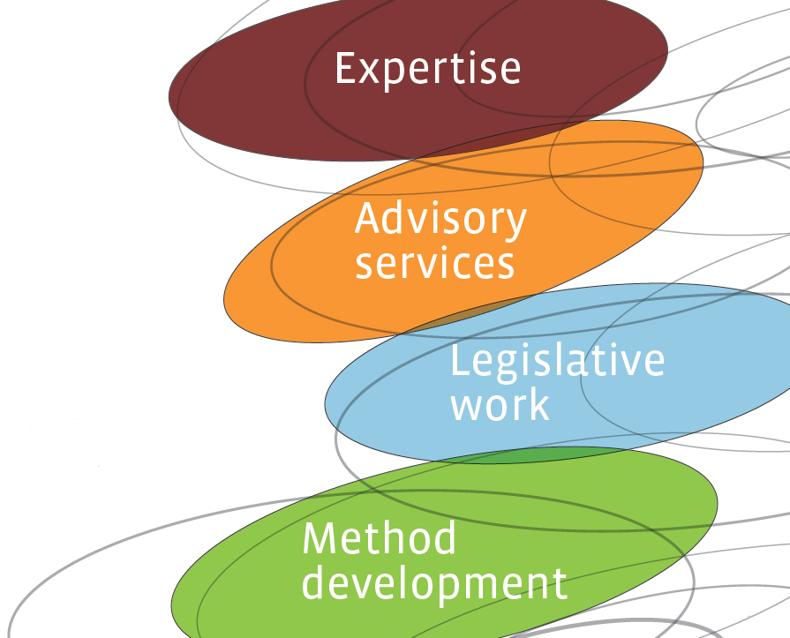
Our Foundation
We provide current knowledge, advice and process support in social affairs.
And we aim to promote new development and initiatives in social services while also supporting and counselling local authorities in providing services to citizens
Notes:
children and young people, the elderly, the disabled, socially marginalized groups, e.g. drug addicts, homeless people, prostitutes.

Slide 11
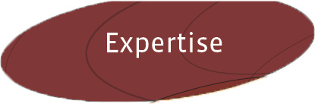
Expertise with Results
Generate new social expertise
Provide access to knowledge at the highest professional level by systematically collect, develop and process knowledge of social practice on the target groups, active methods, organization and social practice.
Notes:
Expertises are build by working closely with the local authorities, social service providers and national and international networks
Using our experience, we qualify and document the knowledge we gain – knowledge that can easily be put into actual practice

Slide 12

Advisory Service
Provide advice to municipalities, regions and citizens
Assist municipalities with general advice on social policy and the special counseling on both the social and the special education field.
Contribute to elucidation of the most complex and specialized individual cases.
Notes:
We advise and consult with professionals in local authorities, organisations and private citizens
A key task is to provide advisory services and a sounding board on social issues

Slide 13

Cohesive Legislation and Practice
Support the development and implementation of social policy
Support the Ministry of Social Affairs, Children and Integration with advice on the best information available for the legislative work; both development and implementation of legislation.
Notes:
We use the knowledge gained from our cooperation with local authorities and organisations to inspire new legislation
Projects are conducted to help put new legislation into practice in the local authorities

Slide 14

Methods for better social practice
Communicate and disseminate effective methods and practices
Provide social expertise at the highest professional level to citizens, administrations and institutions in municipalities and regions.
Support the efficient dissemination and implementation of effective methods and practices in the social sphere, based on the best information available.
Notes:
Through systematic work we test, implement and follow-up on the
methods and focus special attention on documentation.
We strive to identify, develop and document new methods
for practical social work.

Slide 15
The role of the National Board of Social Services
The Danish Parliament
- decides the political social and welfare initiatives to be implemented
The National Board of Social Services
- ensures that such initiatives are put into practice by municipalities
- counsels and assists local authorities
- offers specialist consultancy in complicated individual cases in the field
Municipalities
- implement the initiatives with the guidiance from the Board
- Take responsibility for social practice

Slide 16
Social Services Legislation
People with reduced functional capabilities should to the extent possible be compensated for the consequences of their disabilities.
Disabled people must be able to function as normally as possible given the extraordinary strain that results from their disabilities.
The Act on Legal Protection and
Administration in Social Matters
The Act on Social Services
The Health Act
§
Notes:
1. Citizen involvement
Time limits for decisions
2. VISO – National Knowledge and Specialist Consultancy Centre
Respite care
Interior design and home relocation
Subsidies for day-care facilities
Residential care facilities
Action plans for adults
Aids and equipment
Club facilities and special club facilities
Local authority counselling
Subsidies for cars
Loss of earnings
3. Special preventive health services, children and youth
Subsidies for dental care
Subsidies for transportation
Subsidies for nutritional products
Subsidies for physiotherapy
Subsidies for psychological counselling

Slide 17
Disadvantaged children and young people
Disadvantaged children and young people may be in need of specialized support. The aim is to provide disadvantaged children and young people with optimum conditions during childhood and adolescence.
Notes:
Disadvantaged children and young people may be in need of specialized support such as consultancy services, educational or other support in the home, family treatment or help to solve their problems. They may also have a need for care outside the home or an offer of practical training. The support for disadvantaged children and young people must be given at an early stage and coherently. The objective is to provide disadvantaged children and young people with optimum conditions during childhood and adolescence, so that their possibilities for personal expression, development and health care are the same as those of their peers.
Recent policy initiatives includes measures focused on early intervention and measures aimed at combatting violence and sexual abuse against children.

Slide 18
Daycare
Day care facilities cooperate with patens to provide care for the children and support the comprehensive development and self-esteem of the individual child and contribute to the proper and safe upbringing of children.
Notes:
A day-care facility is the term used for various types of facilities for children under school age. Daycare facilities cover crèche, family day-care, nursery schools and age-integrated institutions.
Facilities for school-age children fall under the term after-school centres. Older children and young people are offered after-school facilities in the form of club facilities and other socio-pedagogic afterschool facilities. The rules on this subject can be found in the Act on Day-Care Facilities but fall under the auspices of the Ministry of Education. The rules on day-care facilities, after-school centres and club facilities and other socio-pedagogic after-school facilities for older children and young people can be found in the Act on Day-Care Facilities.

Slide 19
People with Disabilties
Denmark ratified the UN Convention of 13 December 2006 on the Rights of Persons with Disabilities on 24 August 2009. The general principles in article 3 of the convention are in keeping with the general principles of Danish disability policy, which is founded on the UN Standard Rules on equal opportunities for person with disabilities and comprises principles for compensation, sector accountability, solidarity and equal treatment.
Notes:
According to the UN Standard Rules, a disabled person has limited access to active participation in all aspects of social life compared to non-disabled people. The wording highlights the interaction between a person’s reduced functional capacity and the layout of the surrounding society.
This perception of disability requires disability policy to focus not only on the individuals specific needs for support. Conditions in society must also be changed and adapted, so that disabled people may move about and participate actively in community life on equal terms with non-disabled people

Slide 20
Marginalized adults
The most vulnerable people deserve special attention. The government wants to reduce marginalization, social exclusion and unworthy conditions of life.
The homeless, drug and alcohol misusers, the mentally ill, the prostitutes, vulnerable Greenlanders and adults, who suffer from trauma because of sexual abuse in their childhood are among the people most in need of care.
The Government’s objective is to start a process that can carry these groups from the fringe of society to the core of social policy.

Slide 21
Elder care
High quality elder care is a key component of the Danish welfare model. Public help for the elderly in Denmark is based on the principle of universal right and given on the basis of individual needs.
The Act on Social Service constitutes the main frame work of Danish senior policy. In general, all services are tax financed. Regardless of private economic abilities all Danish citizens therefore have access to eldercare.
Notes:
Like many other countries Denmark is faced with the challenge of an ageing population. According to statistical analysis the number of Danish citizens older than 80 years will grow to 450,000 in 2040, which means these citizens are most likely to be in need of practical and personal help.
To meet this challenge the Danish government has launched an ambitious social reform programme that aims to ensure both a sustainable social system and high-quality social services. This includes helping elderly citizens stay healthy for a longer period of time and an increased use of intelligent welfare technology

Slide 22
Civil Society
A well-functioning welfare state requires not only a strong private and public sector, but also a strong and committed voluntary sector. Volunteering creates strong communities across generations and social backgrounds.
Notes:
The Government appreciates the tremendous effort many people make in voluntary work and recognize the necessity of the volunteer involvement and participation in the social field. A well-functioning welfare state requires not only a strong private and public sector, but also a strong and committed voluntary sector. Volunteering creates strong communities across generations and social backgrounds.
It is the public sector, which has the primary responsibility for marginalized children, youth and adults. The voluntary sector is an important addition, because it can create a different kind of trust and contact with other people.
Charter for the cooperation between the voluntary sector and the public sector The Charter for cooperation between the voluntary sector and the public sector describes the fundamental values and frameworks for interaction. It is prepared by representatives of the two sectors together back in 2001. Now it is about to be renewed and kept up-to-date.
More than 10 years have passed since the Charter was originally formulated. And both the voluntary sector, the public sector and the welfare state has changed significantly since then. The revitalized charter was published in summer 2013.

